Slide 1

Block Size Changeover
7.10.24 version 1.0

Slide 2
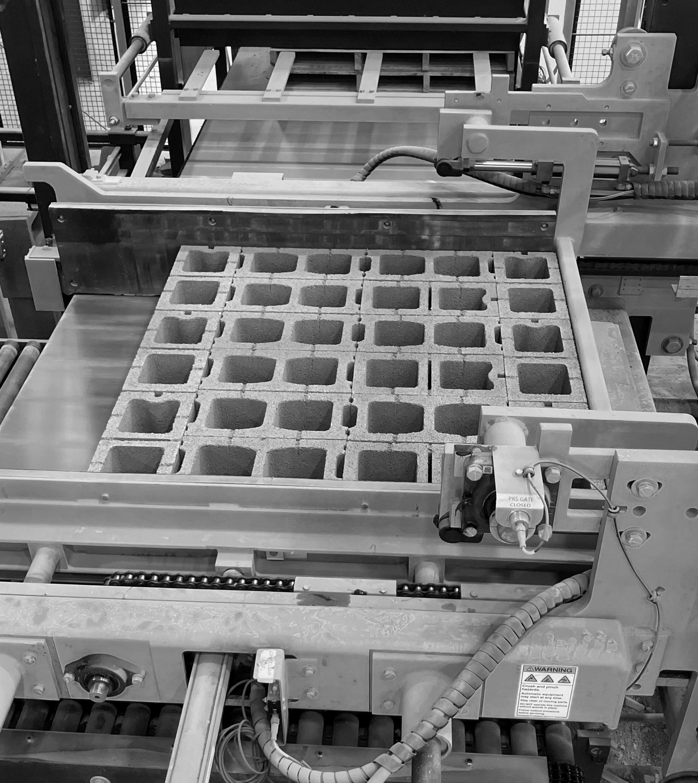
Assumptions and Prerequisite Skills
The Machine is in manual
Adhere to all lockout/tagout and confined space requirements
Supplies Needed
Standard PPE Equipment

Slide 3
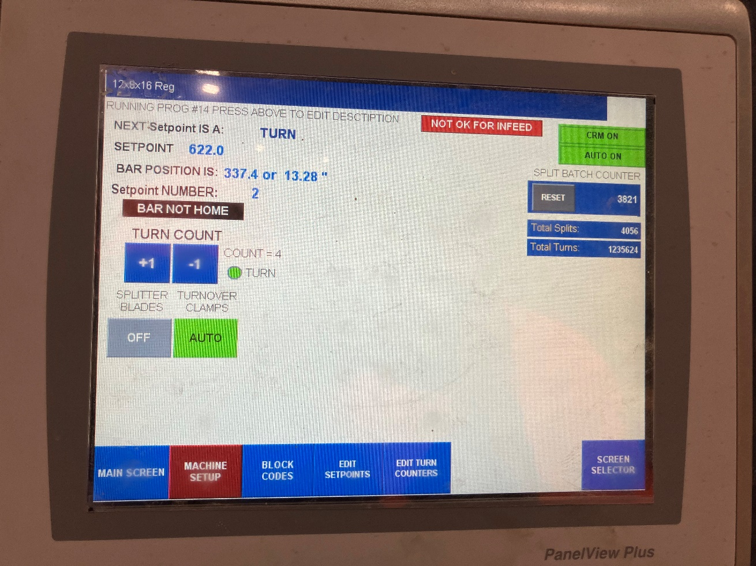
1. At the Depalleter Control Panel, press the “Screen Selector” button in the bottom right corner of the screen (Figure 1).
Figure 1

Slide 4
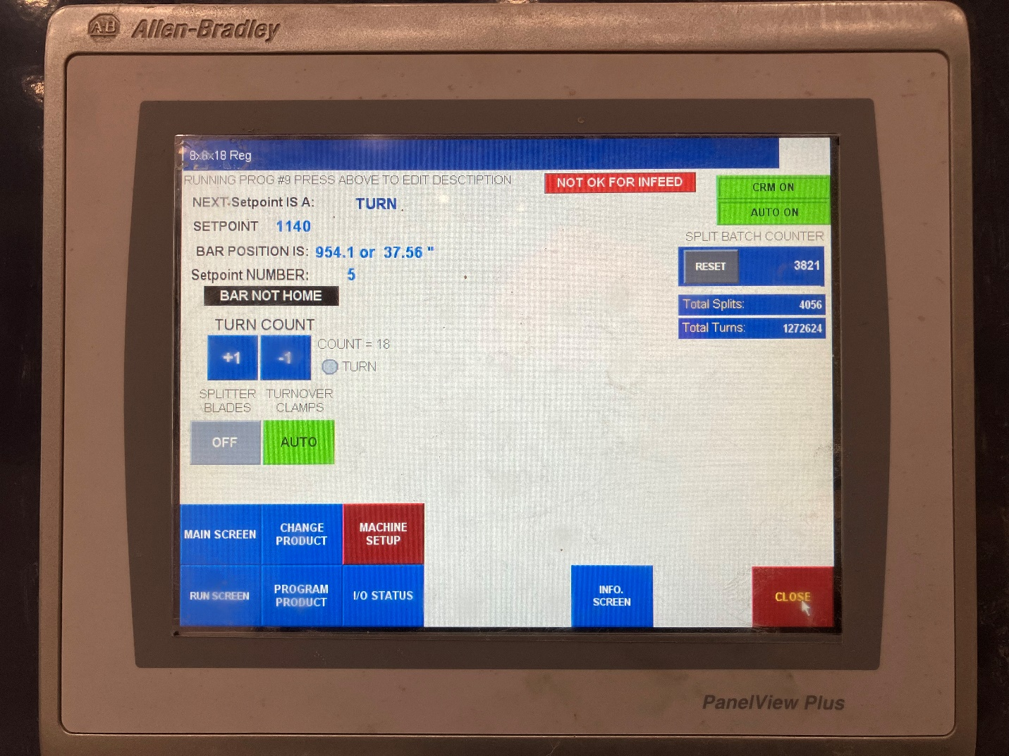
2. From the options that pop up in the bottom left corner of the screen, select “Change Product” (Figure 2).
Figure 2

Slide 5
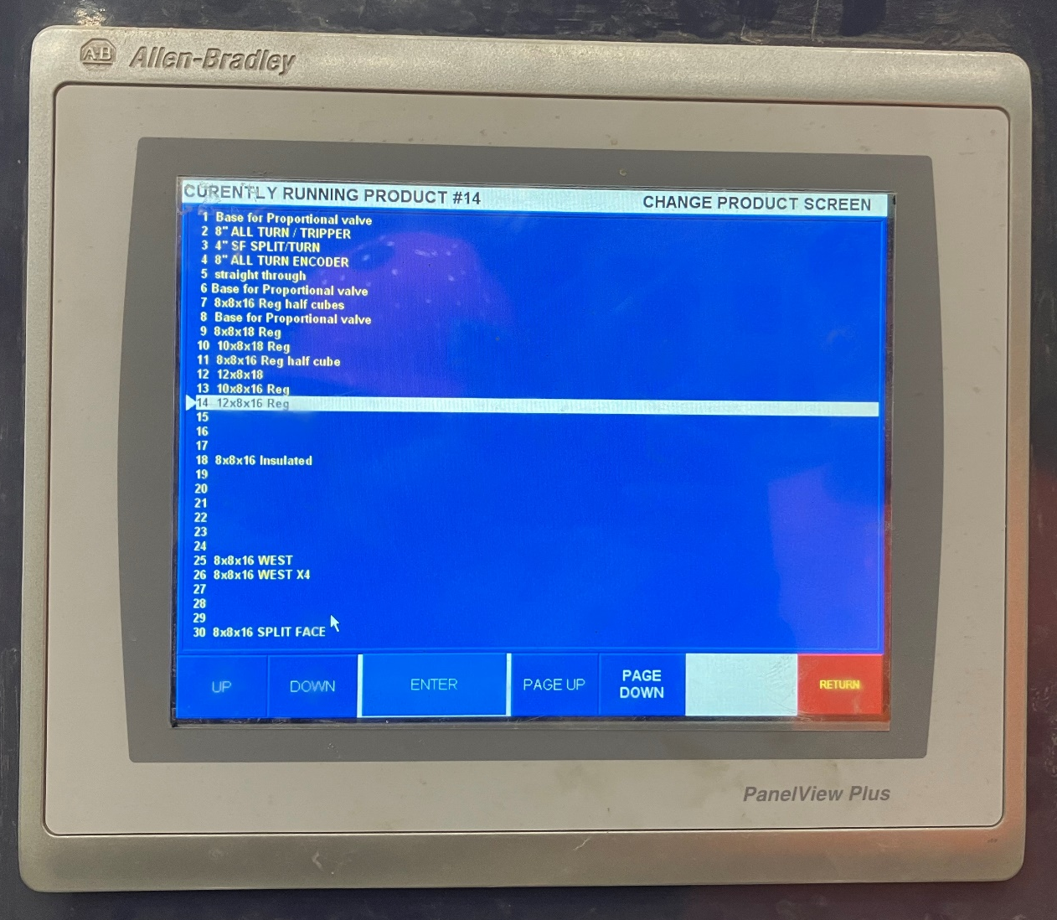
3. From the list of options, select the number of the product you will now be using (Figure 3, yellow arrow). Then press enter at the bottom of the screen (Figure 3, red circle).
Figure 3

Slide 6
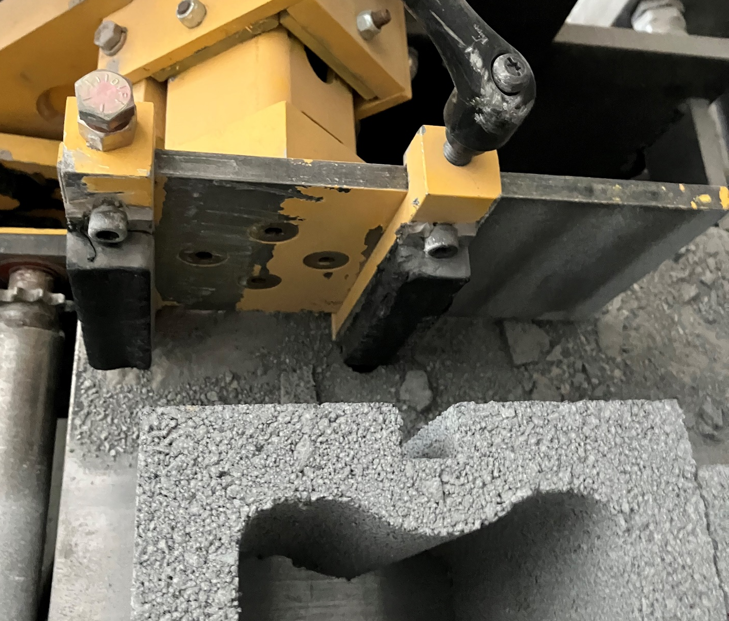
4. Use the handle screw to move the block turnover clamps either closer or farther away from each other to fit the width of the block (Figure 4).
Note: See next slide for pad placement.
Figure 4

Slide 7
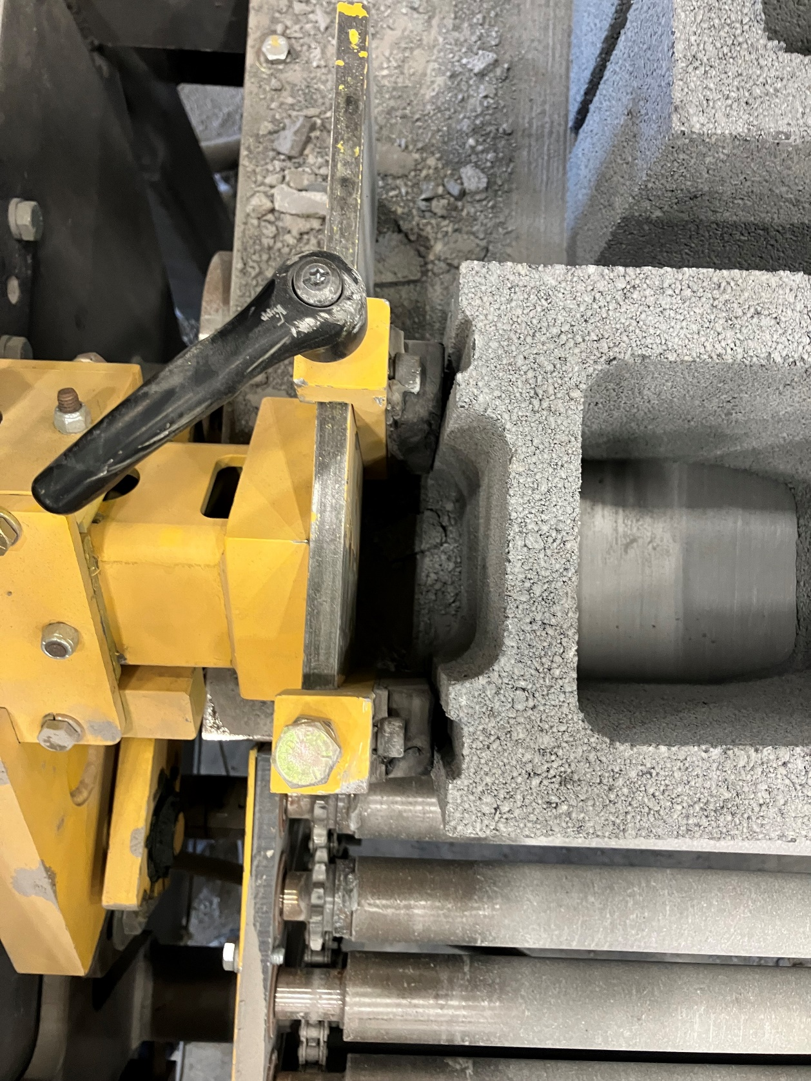
NOTE: On blocks that have stretchers (see figure 5), the clamps must line up with the stretchers.
Figure 5

Slide 8
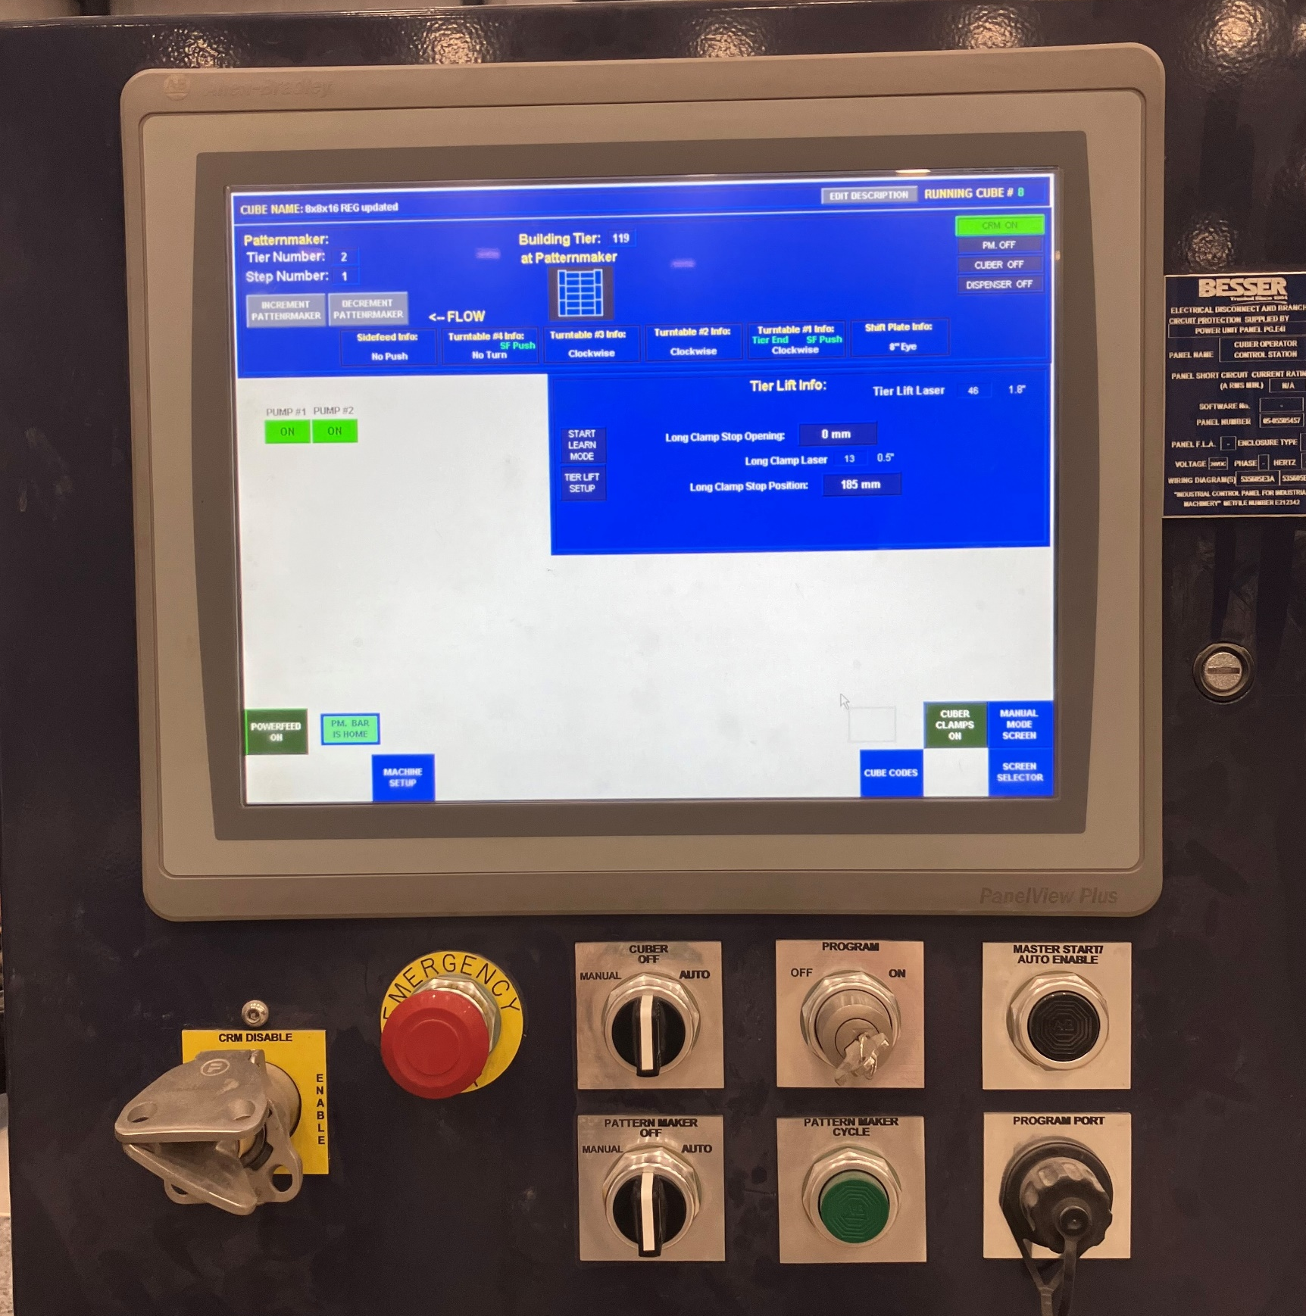
5. At the Cuber Control Panel, turn the “Cuber” switch and the “Patternmaker” switch to off. Take the fortress key out of the panel (yellow arrow).
Figure 6

Slide 9
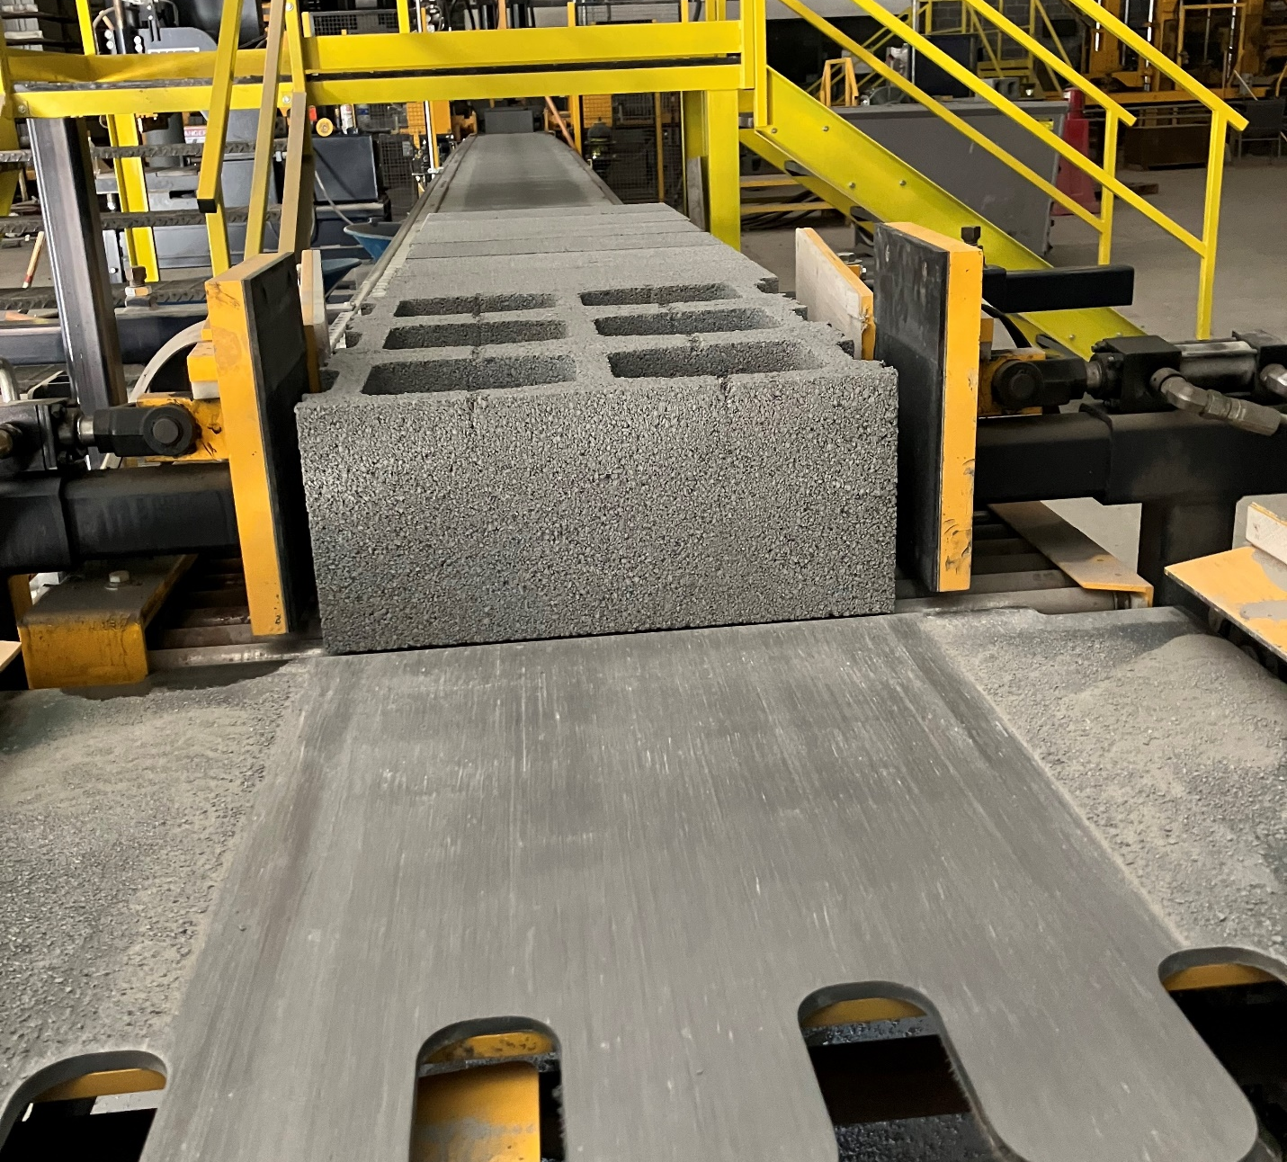
6. Using a 9/16 wrench, unscrew the bolts on either side of the clamps to move the clamps either inwards or outwards depending on whether the new block is larger or smaller than the previous block (See next slide). Once the clamps are in the proper location for the block you will now be using, screw the bolts back on until secure.
Figure 7

Slide 10
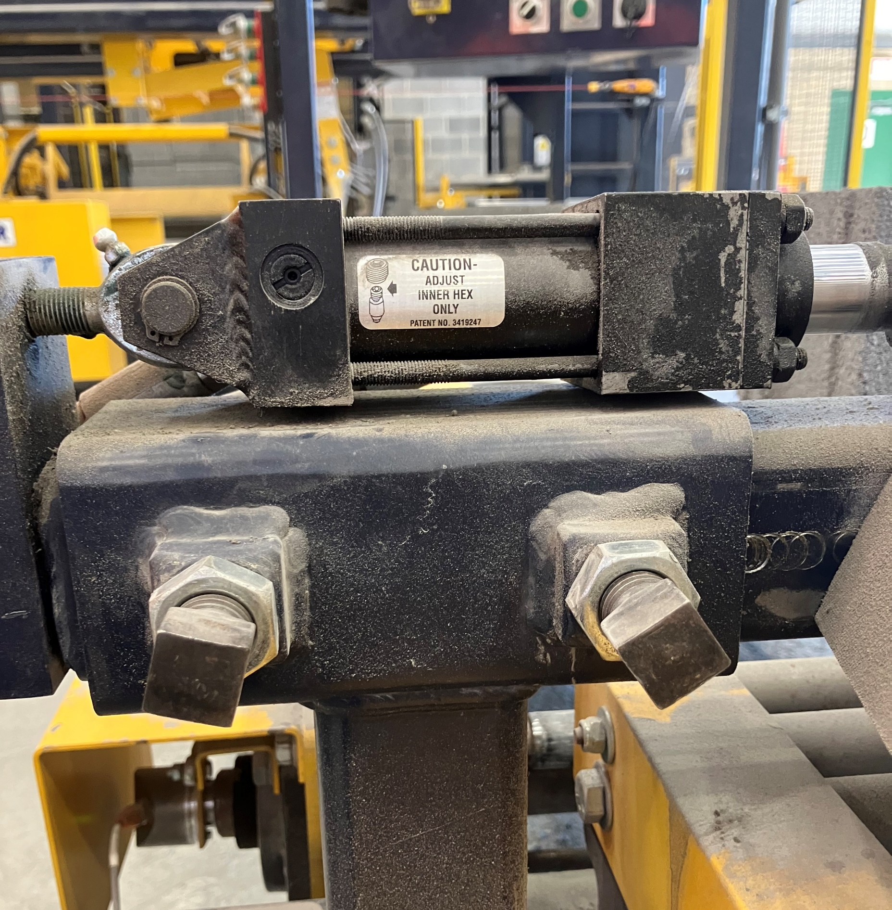
Figure 7

Slide 11

7. At the patternmaker clamp, use a ratchet wrench to move the patternmaker clamps closer or further away depending on whether you are using a larger or smaller black.
NOTE: When both clamps are engaged and holding the block, the block position must remain in the same orientation as the blocks coming down the conveyer.
If blocks are shifted too far left or right, it will cause issues with the patternmaker bar feed and possibly stack problems upstream with jam-ups.
You want the blocks in as straight and orderly of a line as possible going upstream from the clamps.
Figure 8

Slide 12
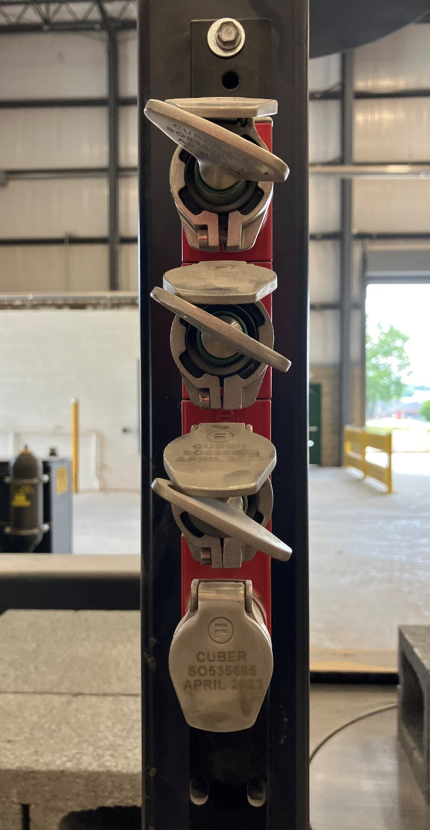
8. Take the fortress key from the panel and put it in the bottom lock on the key holder and turn it clockwise until it stops to be able to remove any of the three keys above. The three keys above are used to access guarding around the cuber. (figure 6)
Figure 9

Slide 13
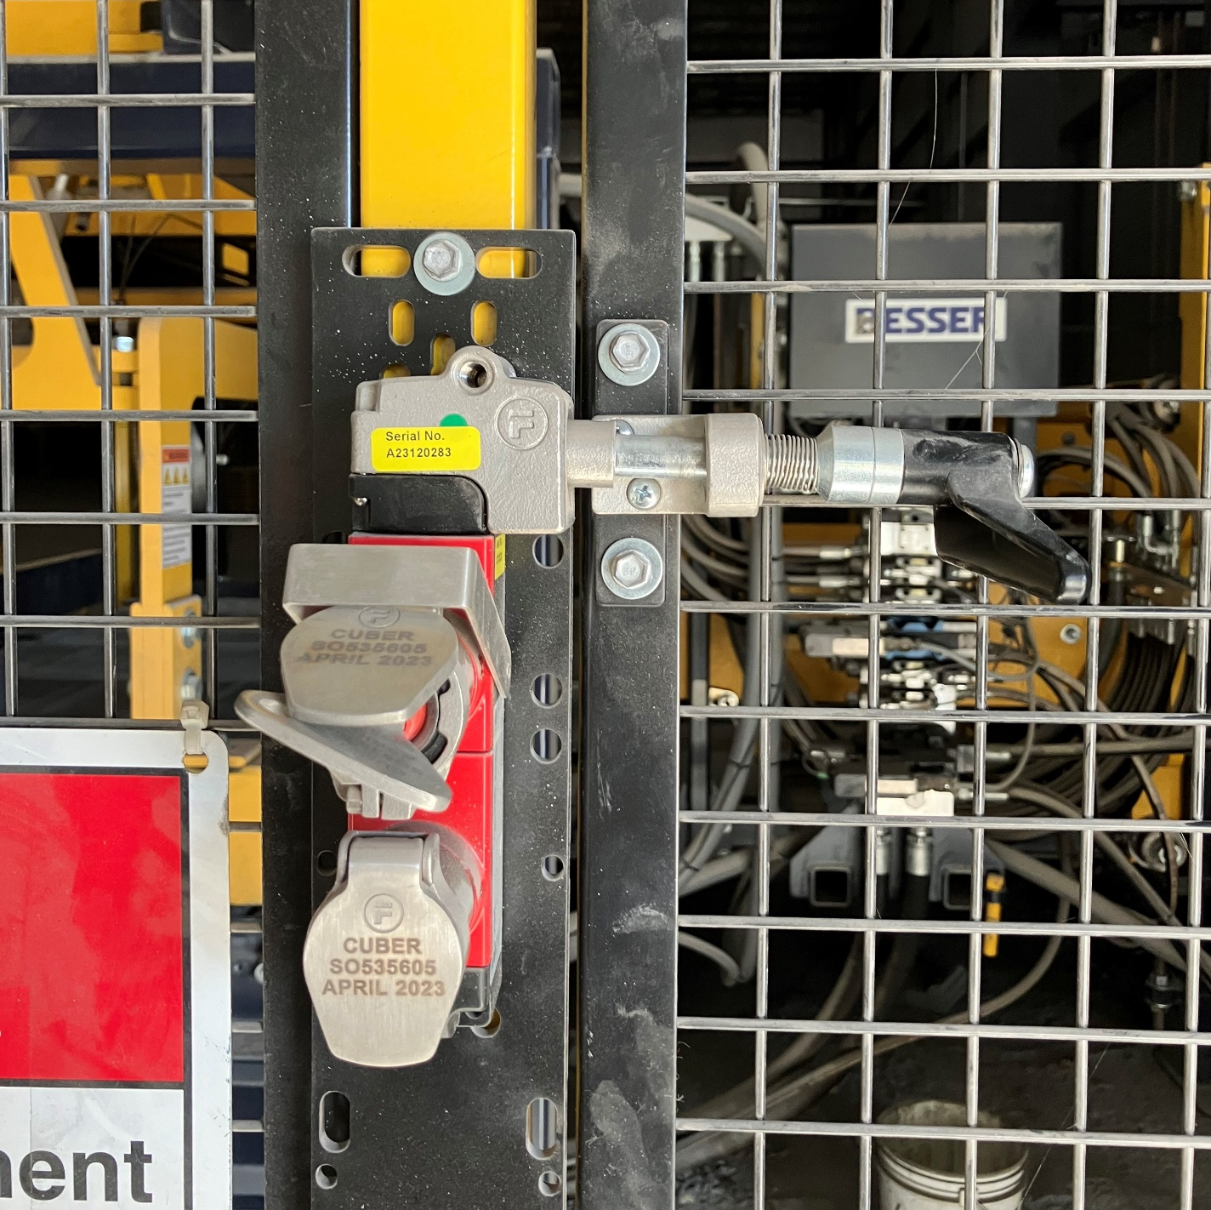
9. At the cuber gate 1, put the key in and remove the key that was originally in the gate. Keep the original key with you until process is done. Unlock the gate.
Figure 10

Slide 14
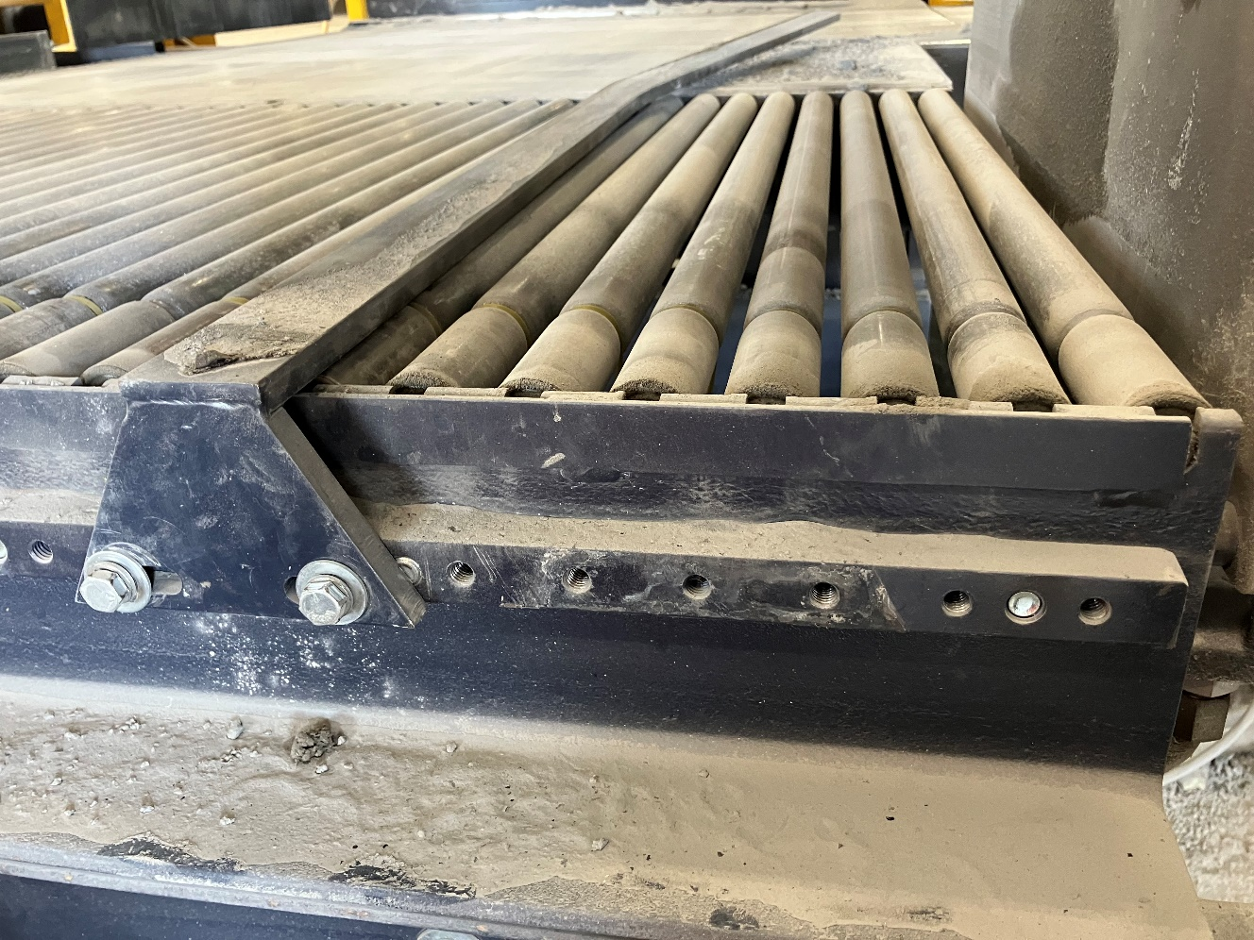
10. Use a 9/16 ratchet wrench to unscrew the bolts and move the guide either close or farther away depending on the size of the blocks. The 3rd and 4th holes from the right are for 18-inch blocks. The 7th and 8th holes are for 16-inch blocks. Reattach the guide and tighten bolts.
16-inch block
18-inch block

Slide 15
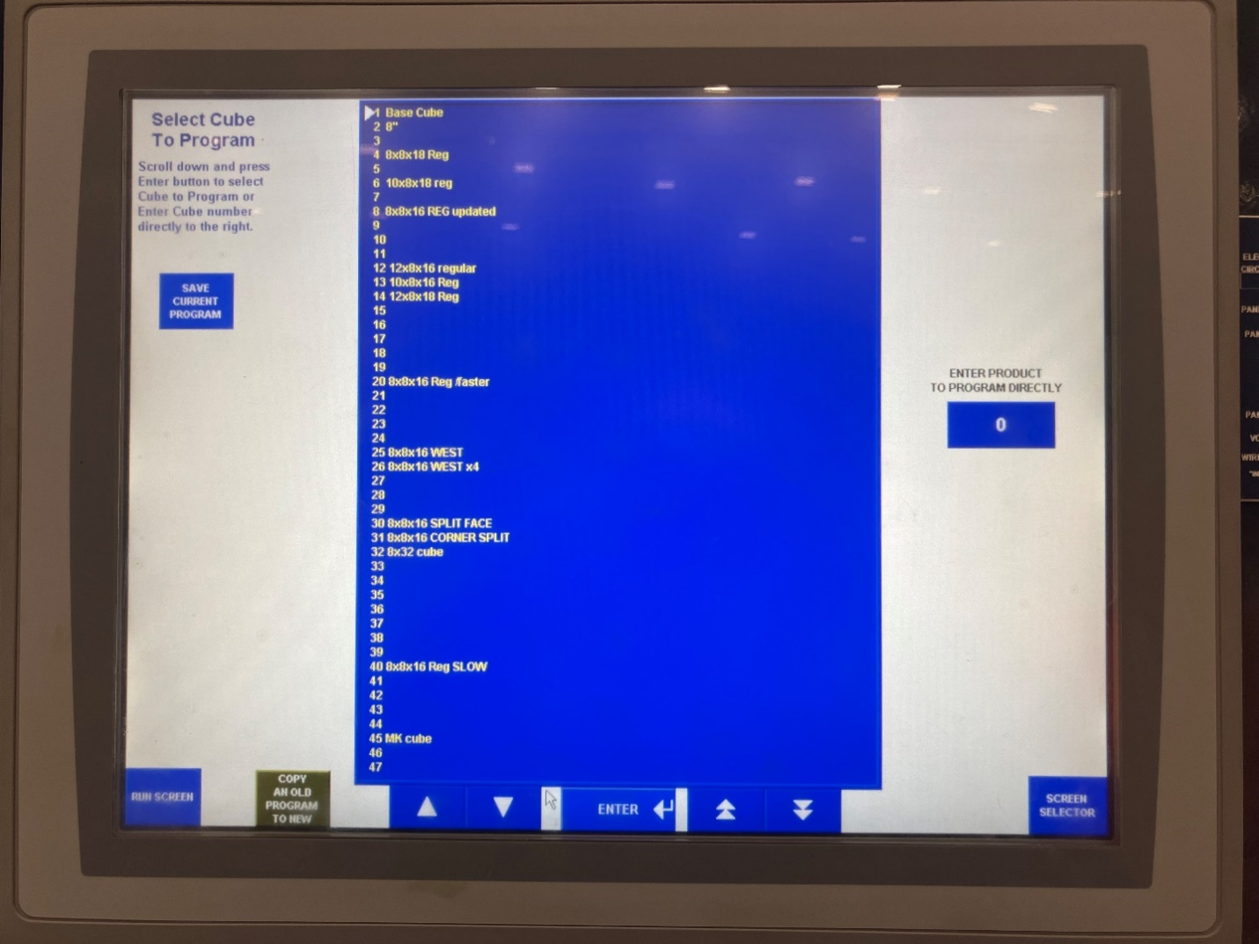
11. Close the guard gate. Take the original key and put it in the top lock and turn it a quarter turn clockwise. Remove fortress key and put it back in the fortress key panel. Remove the Cuber fortress key from the Fortress Key Panel and put it back in the Cuber Control Panel. Turn the key clockwise until you can’t anymore.
12. On the Cuber Control Panel, go to Cube program and select the pattern needed according to the size block you are now cubing.

Slide 16
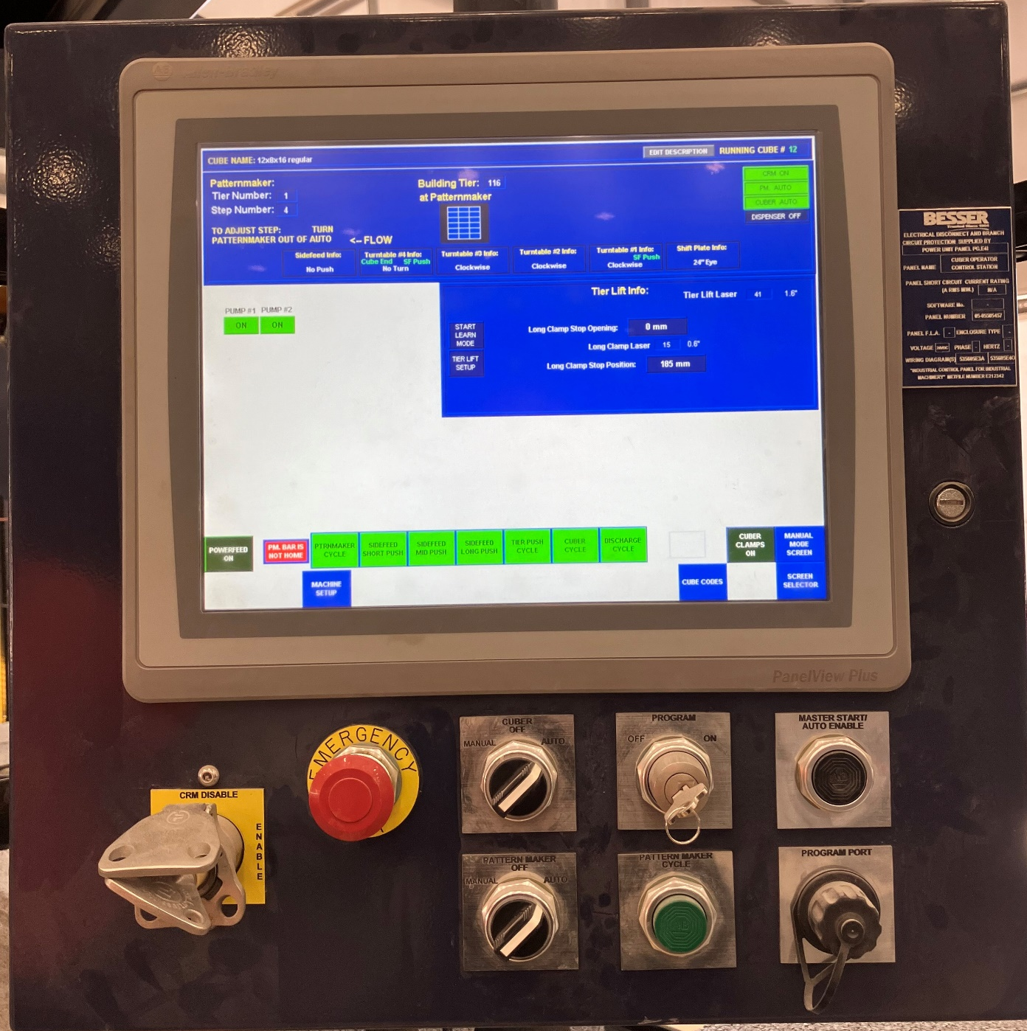
13. Place the original key back in the lock on the cuber control panel. Turn the “Cuber” switch and the “Patternmaker” switch to “Auto” to start the machine again. Push the black “Master Start/Auto Enable” to restart (Yellow arrow).
Make sure to check your work and make sure everything is in place for the new block size.
This completes the process.

